Slide 1
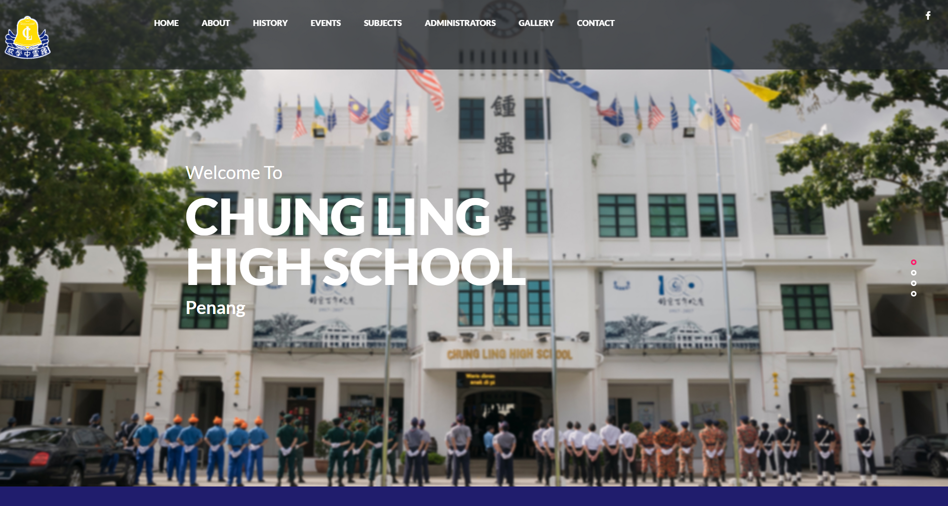
Coolest Project Malaysia Competition Web Category 2019 – team project(2nd place)

Slide 2
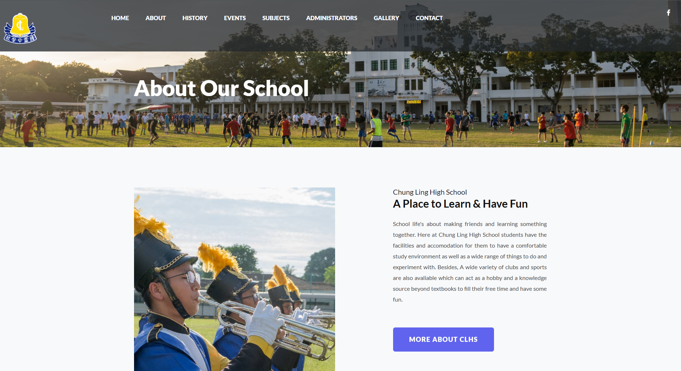
Coolest Project Malaysia Competition Web Category 2019 – team project(2nd place)

Slide 3
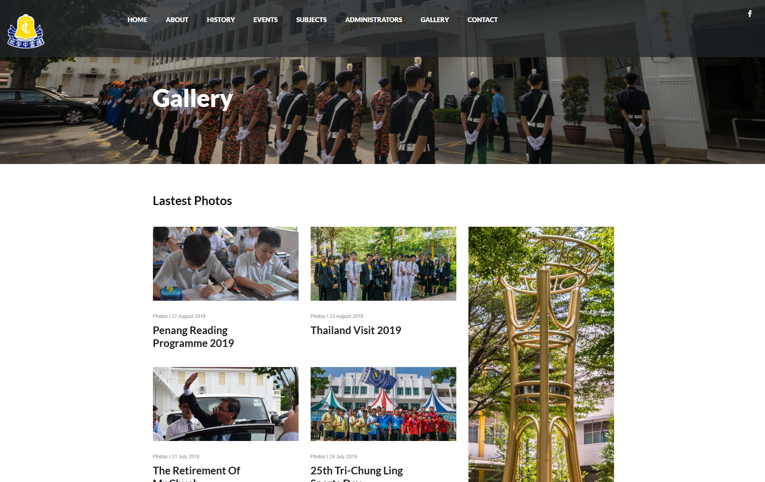
Coolest Project Malaysia Competition Web Category 2019 – team project(2nd place)

Slide 4
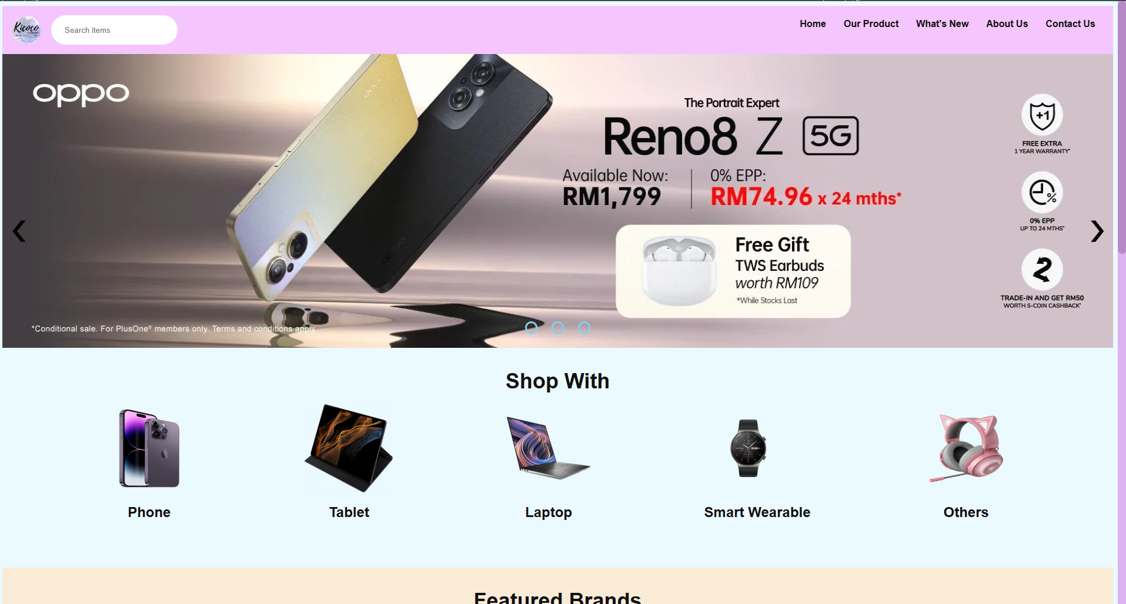
Diploma Web Group Assignment (2022) – Group assignment

Slide 5
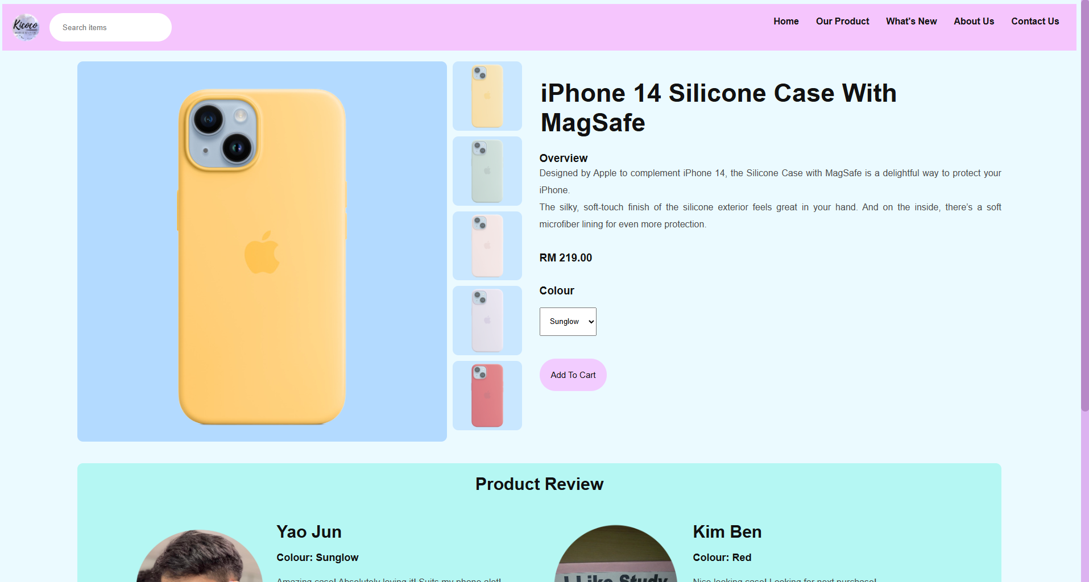
Diploma Web Group Assignment (2022) – Group assignment

Slide 6
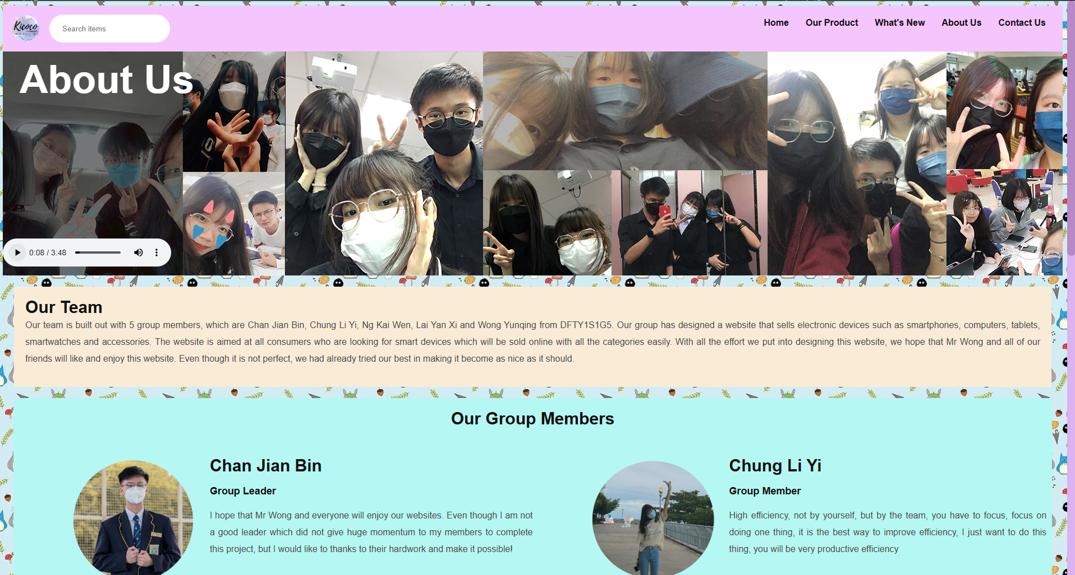
Diploma Web Group Assignment (2022) – Group assignment

Slide 7
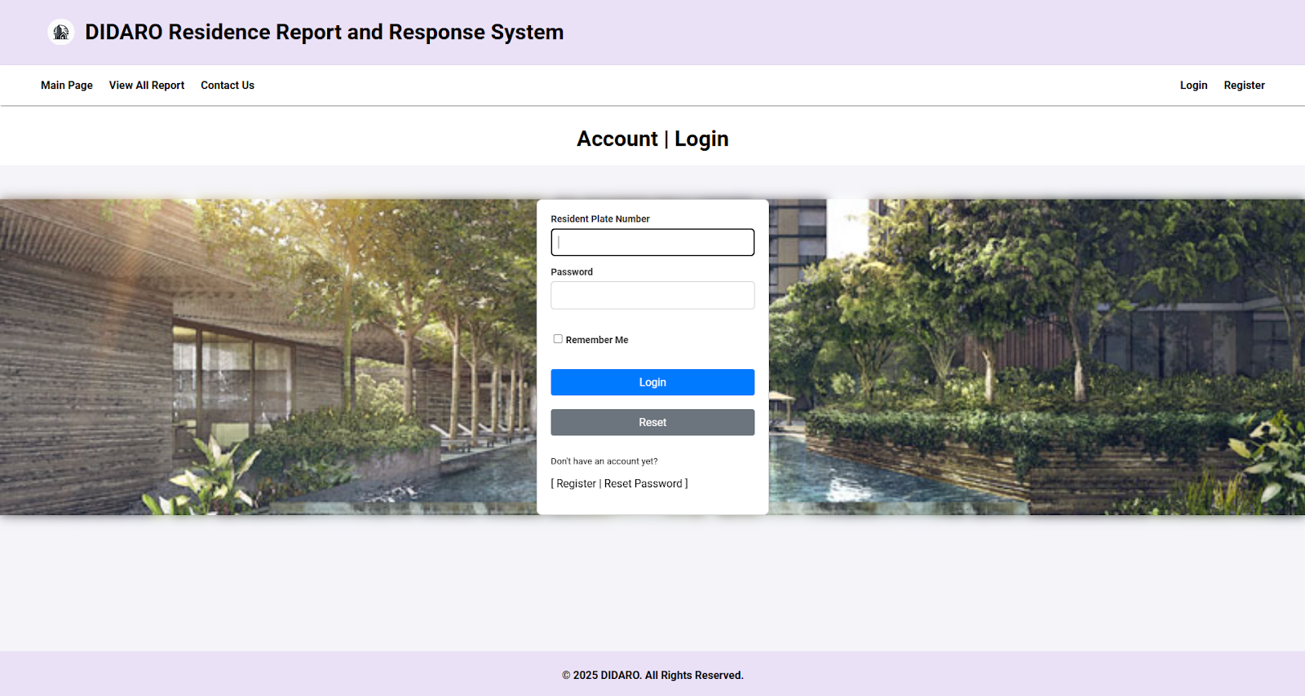
Degree ASP.NET (2024) – Group assignment

Slide 8
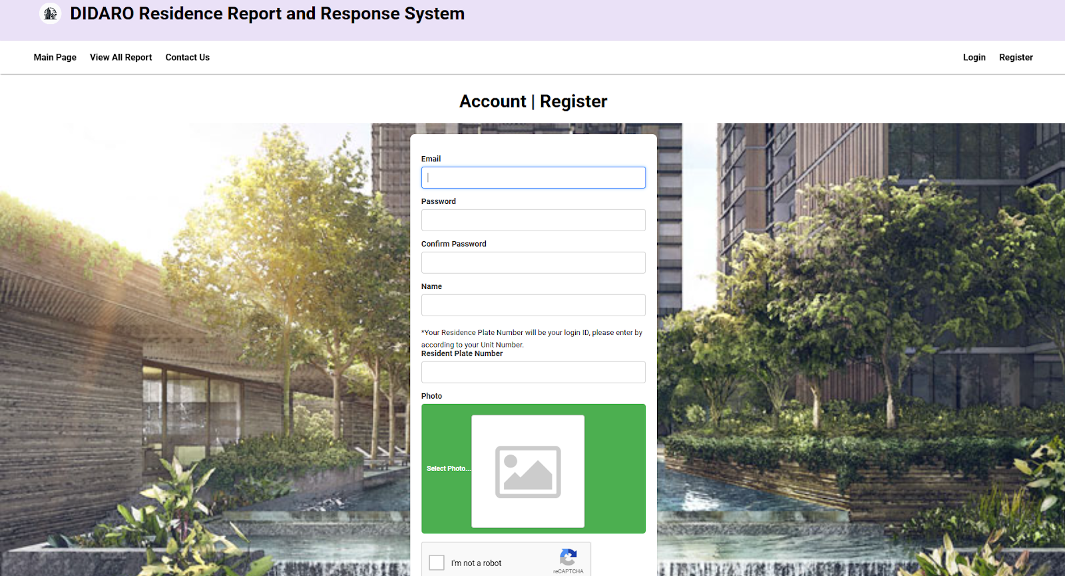
Degree ASP.NET (2024) – Group assignment

Slide 9
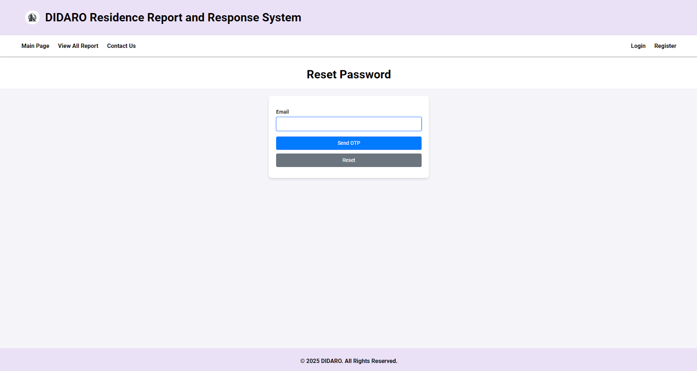
Degree ASP.NET (2024) – Group assignment

Slide 10
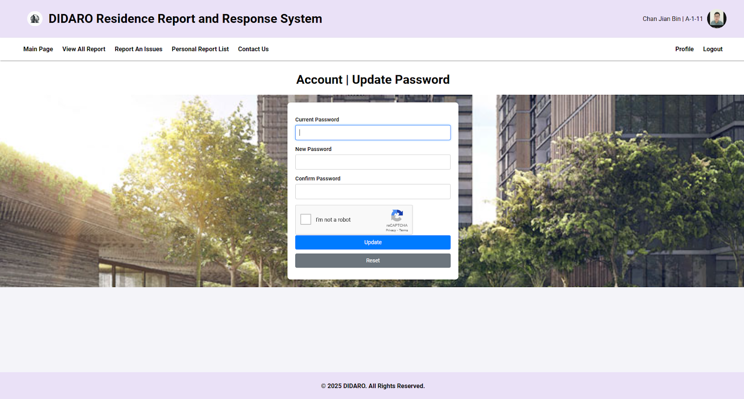
Degree ASP.NET (2024) – Group assignment

Slide 11
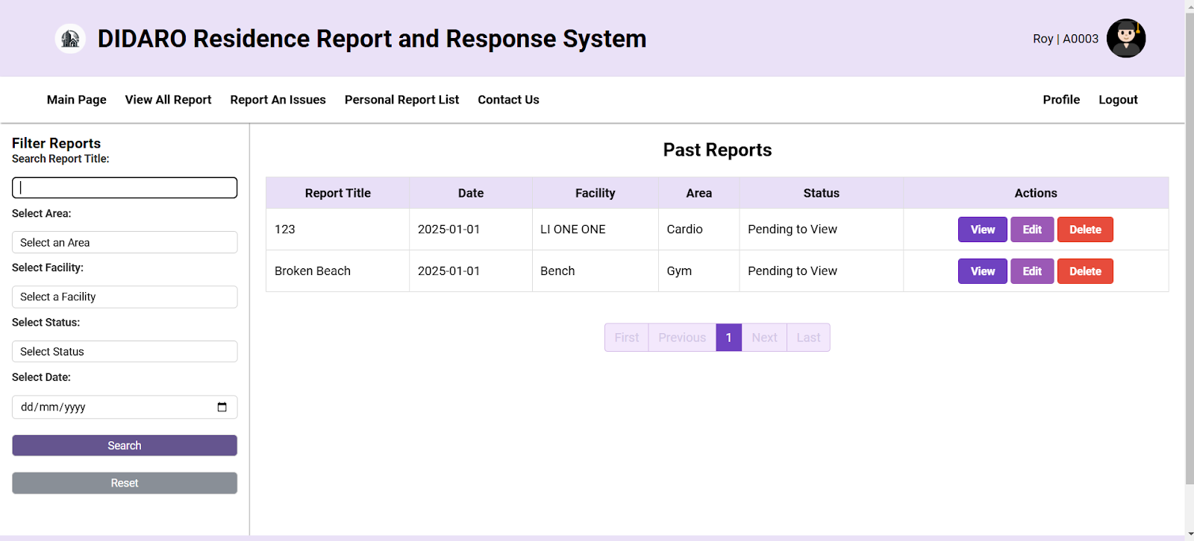
Degree ASP.NET (2024) – Group assignment

Slide 12
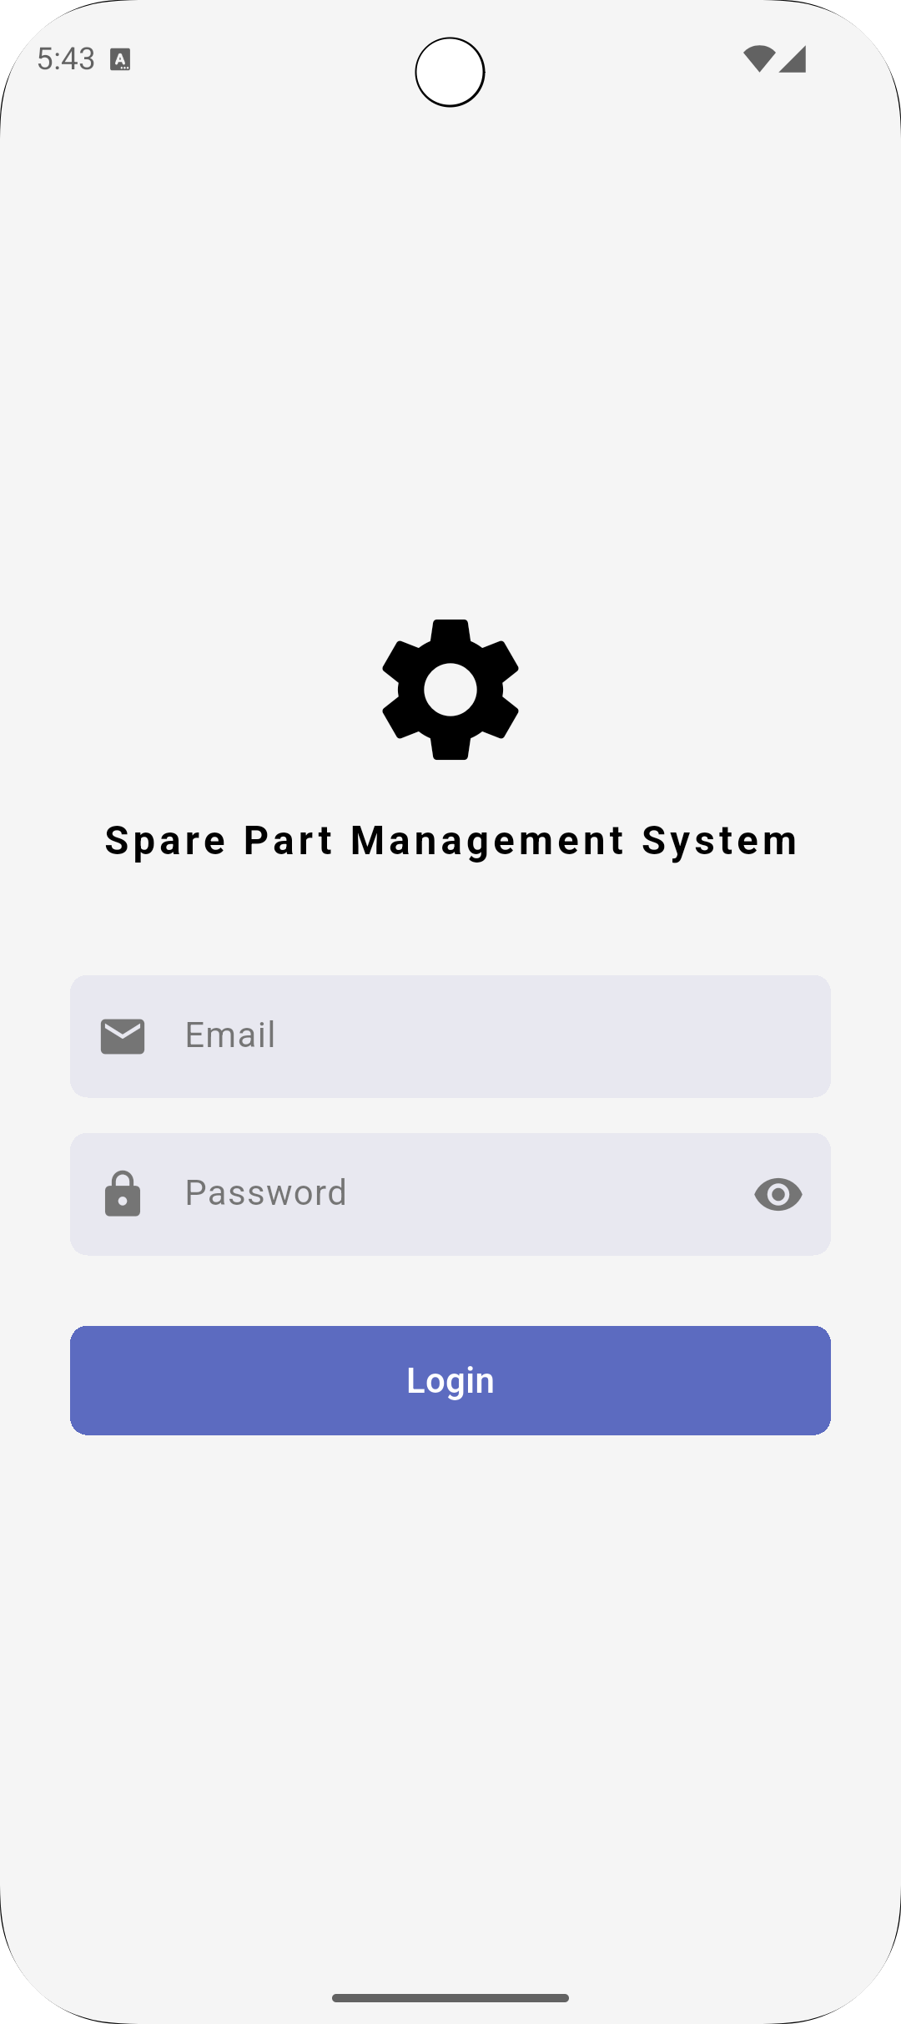
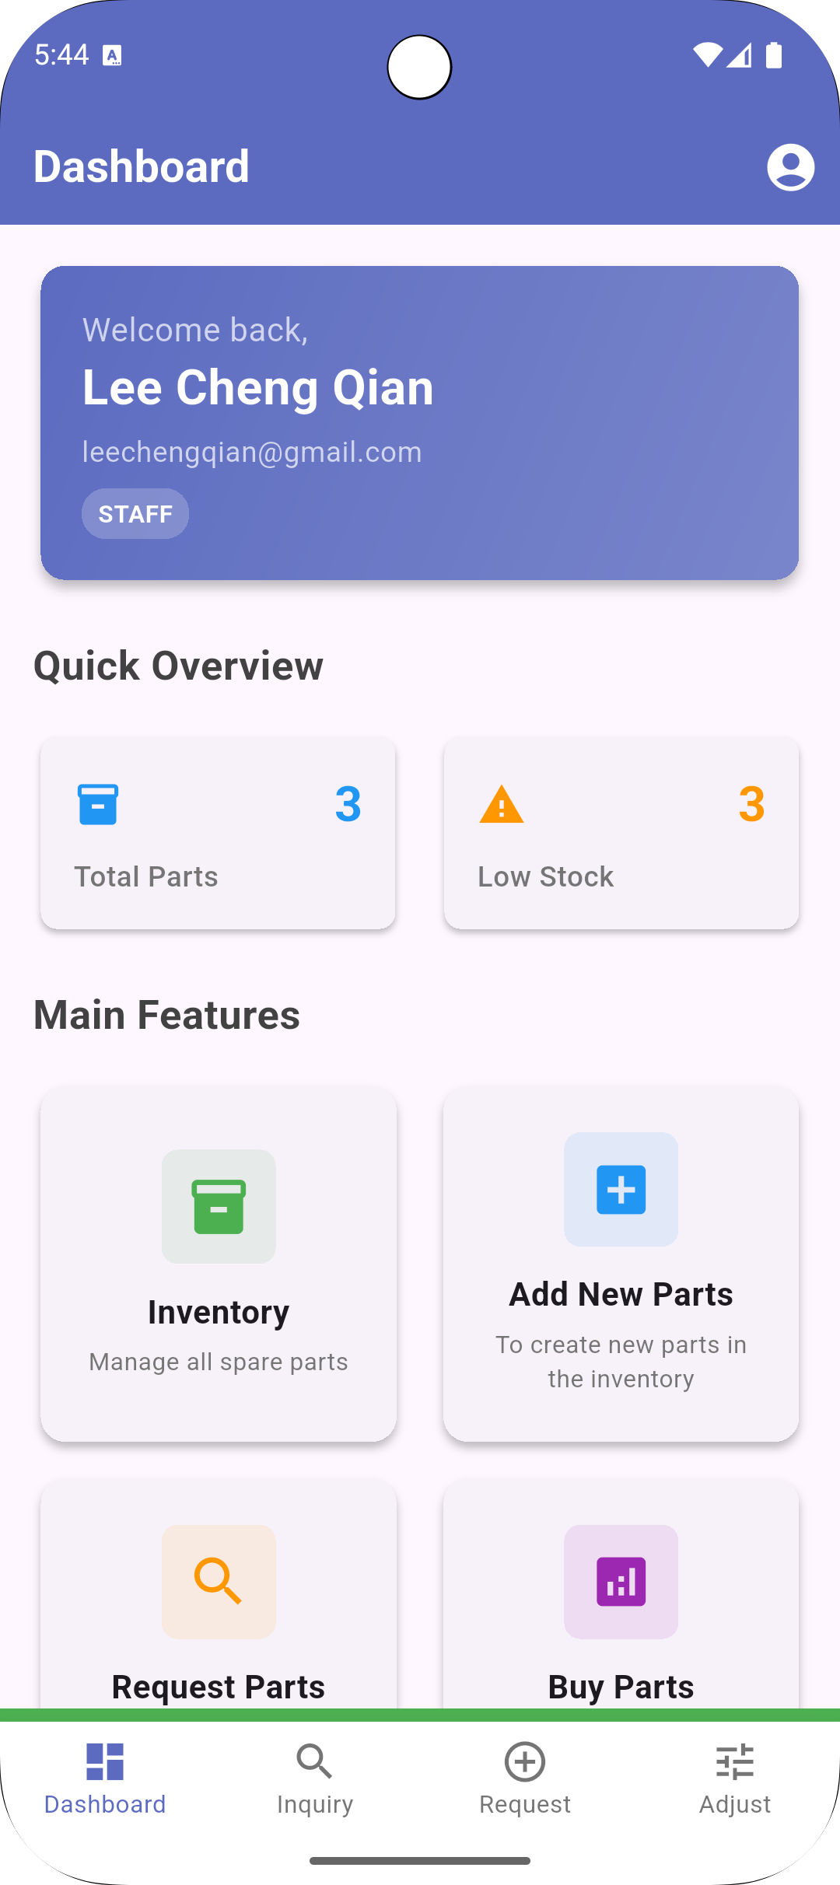
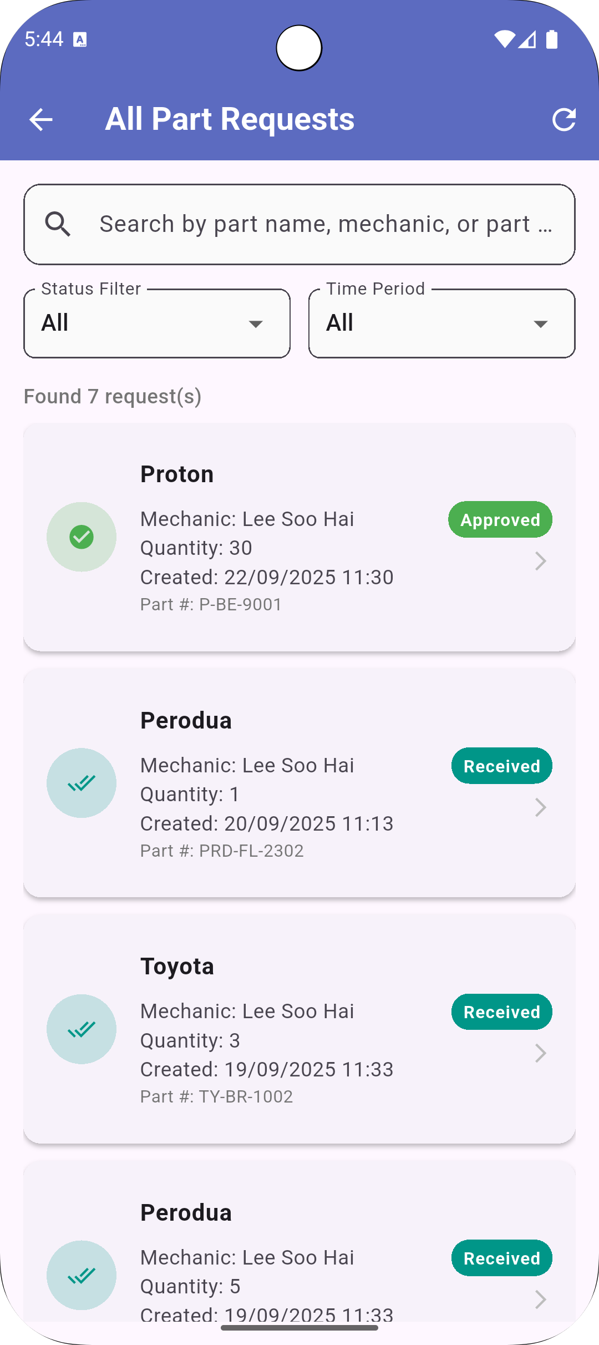
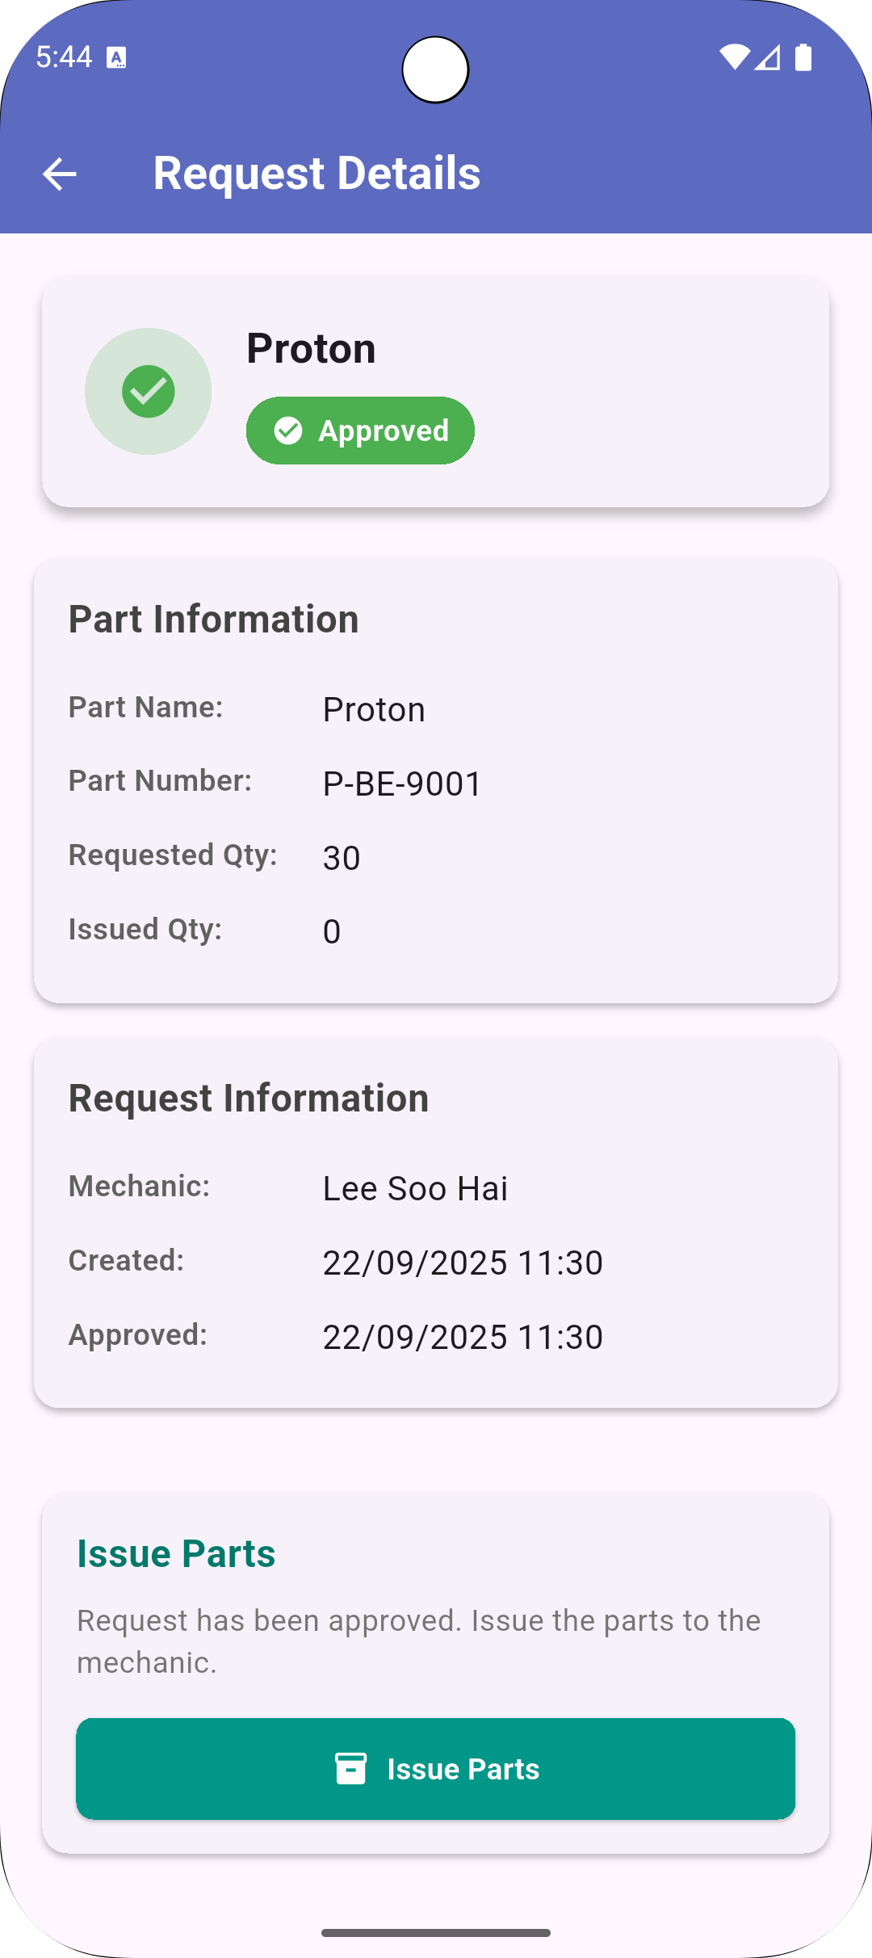
Mobile Application with Android Studio (2025) – Group assignment

Slide 13
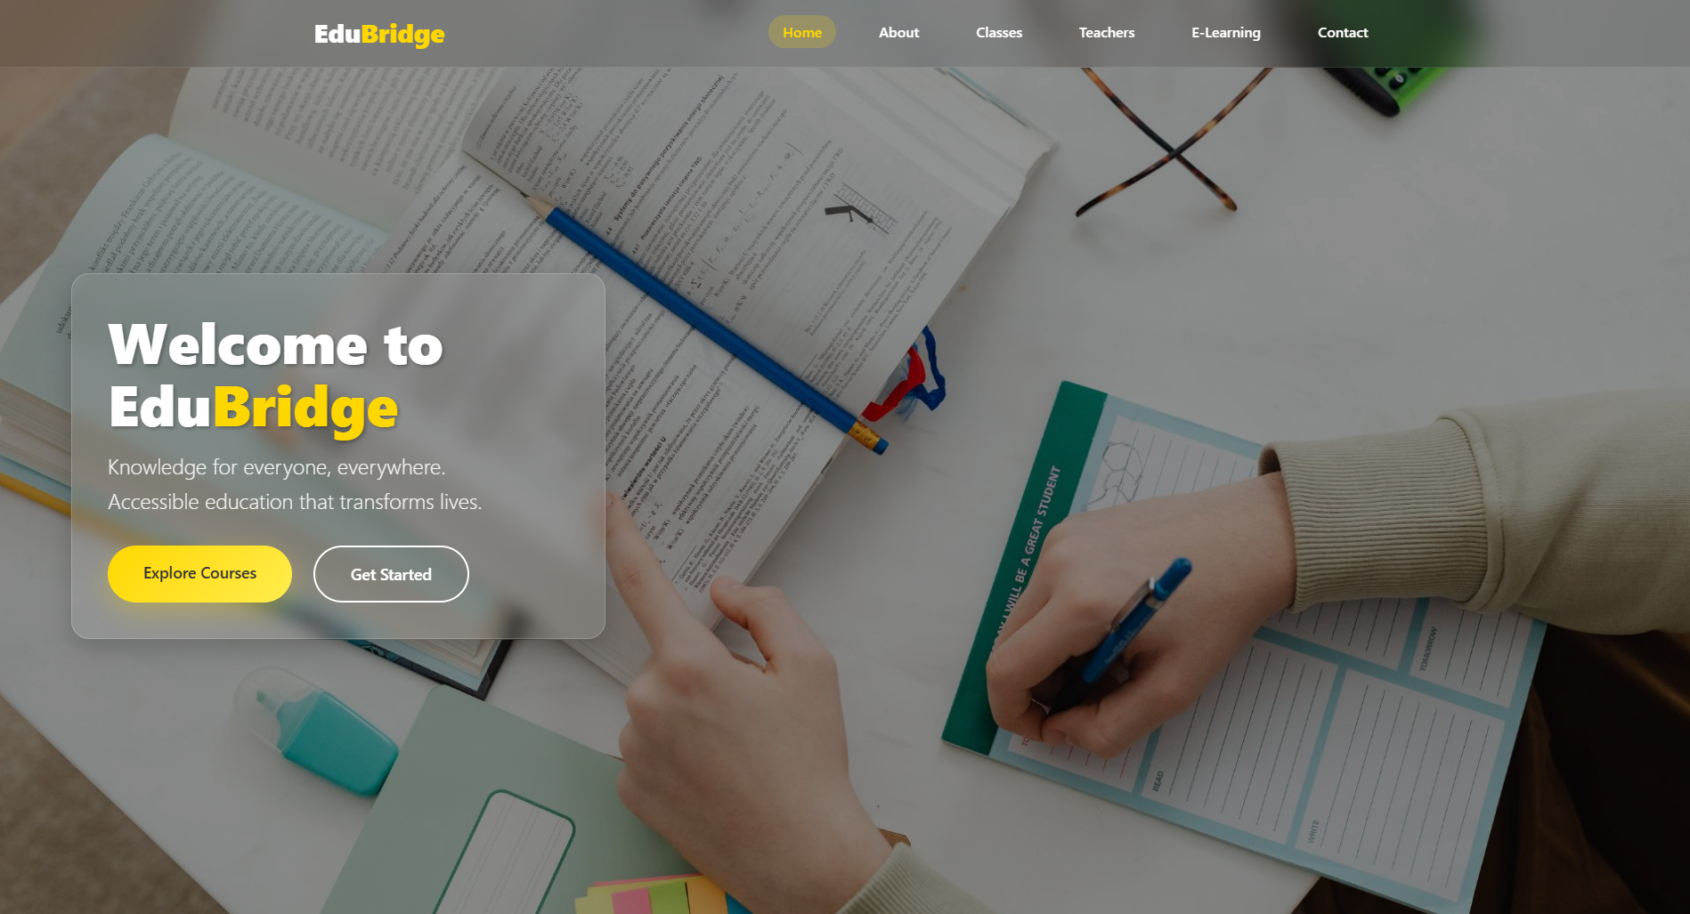
Improve Student’s Web Project – Aimsity, 2025

Slide 14
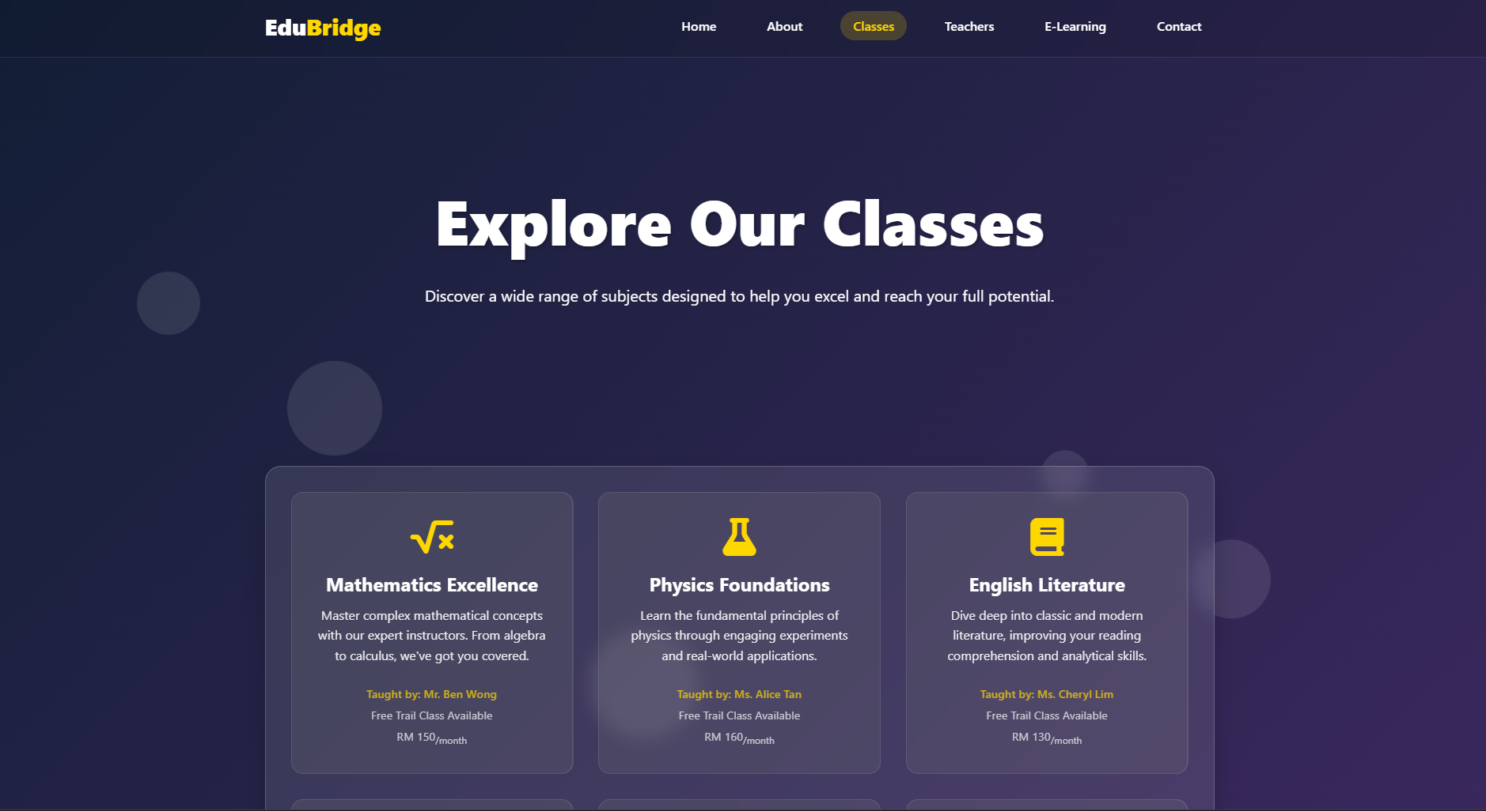
Improve Student’s Web Project – Aimsity, 2025

Slide 15
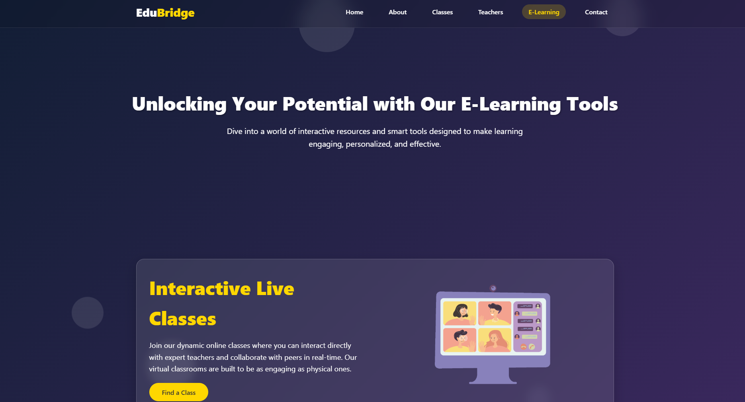
Improve Student’s Web Project – Aimsity, 2025

Slide 16
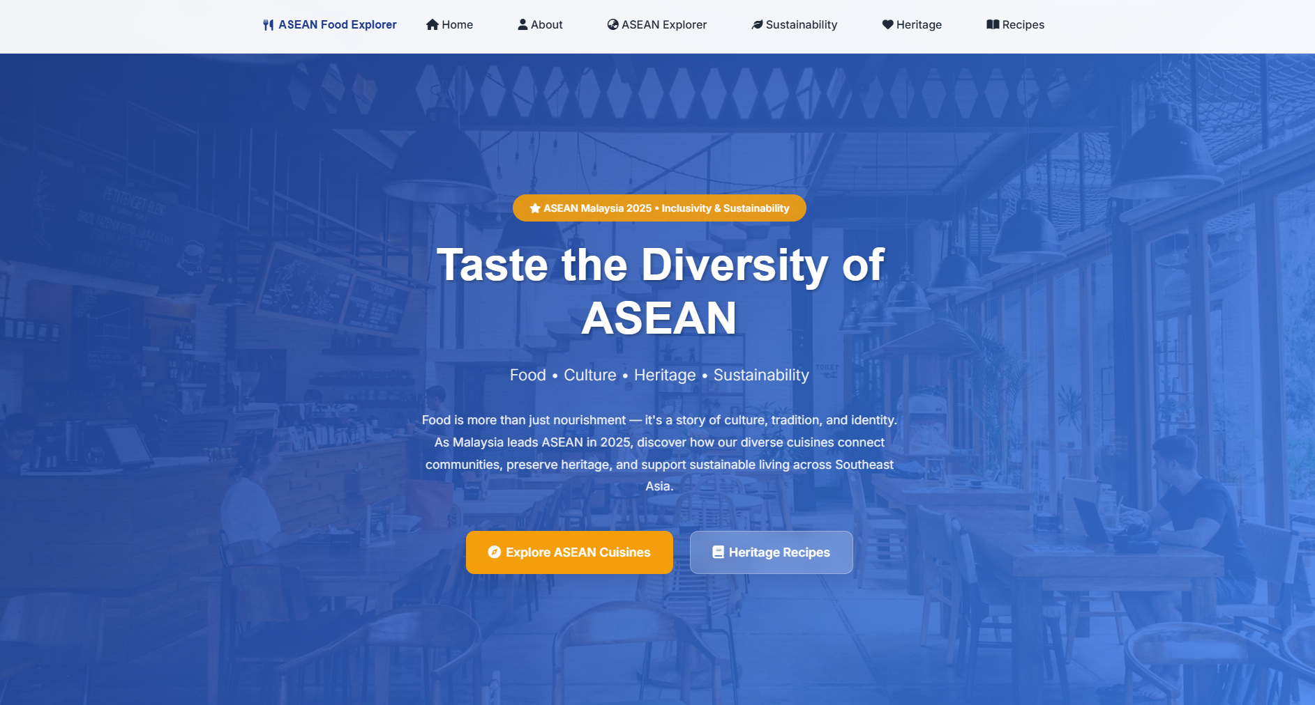
Improve Student’s Web Project – Aimsity, 2025

Slide 17
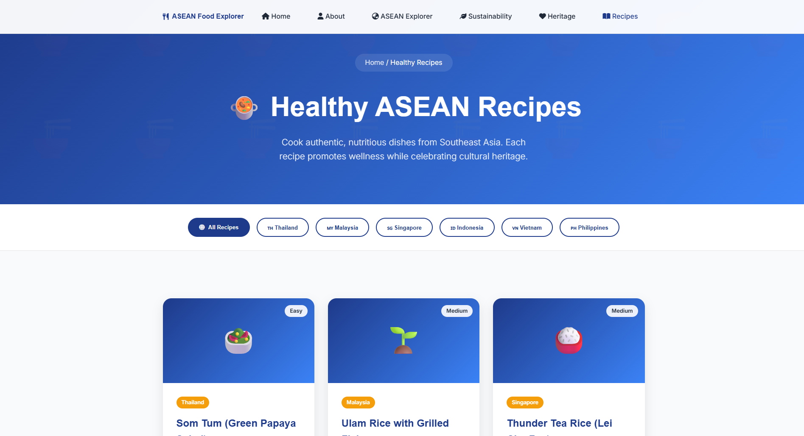
Improve Student’s Web Project – Aimsity, 2025

Slide 18
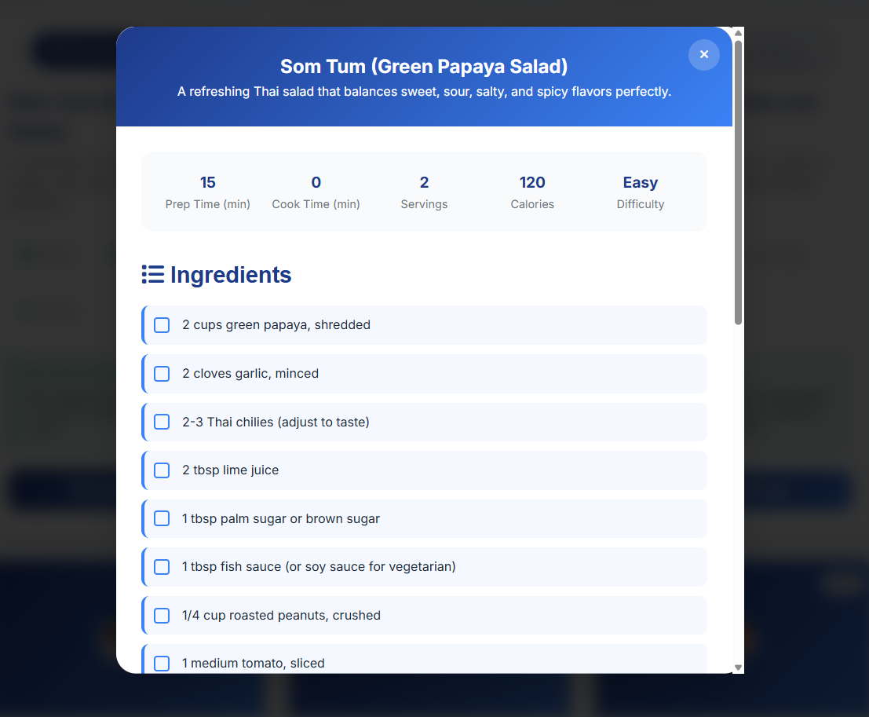
Improve Student’s Web Project – Aimsity, 2025

Slide 19
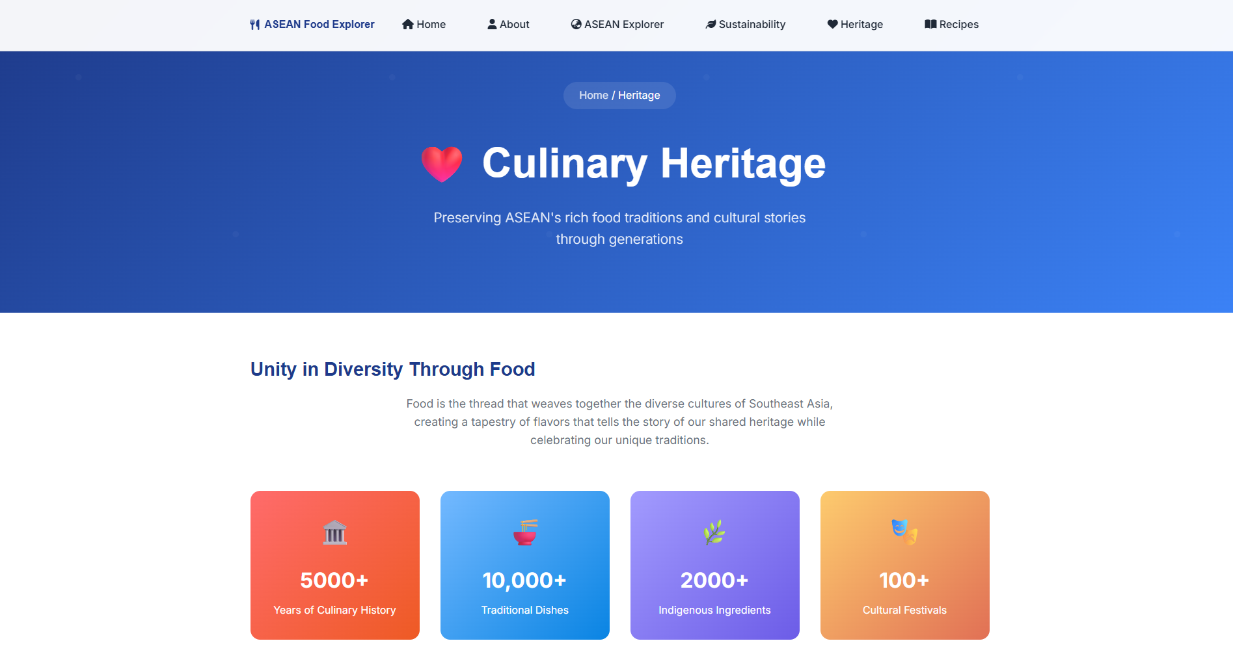
Improve Student’s Web Project – Aimsity, 2025

